Slide 1
Malicious Code (Malware)
CS 5352/6352 Computer Security
Lecture note
Dr. Sajedul Talukder

Slide 2
Malware
CSCA0101 Computing Basics
Malware
Usage of Malware
Types of Malware
How Malware Spreads?
How Can You Protect Computer?
Symptoms
Anti-Malware Program
1

Slide 3
Malware
CSCA0101 Computing Basics
Malware
Short for malicious software.
A malware is a type of software used or created to disrupt computer operation, gather sensitive information, or gain access to private computer systems.
It can appear in the form of code, scripts, active content, and other software.
'Malware' is a general term used to refer to a variety of forms of hostile, intrusive, or annoying software
2

Slide 4
Malware
CSCA0101 Computing Basics
Usage of Malware
Many early infectious programs, including the first
Internet Worm, were written as experiments or pranks.
Today, malware is used primarily to steal sensitive personal, financial, or business information for the benefit of others.
Malware is sometimes used broadly against government or corporate websites to gather guarded information, or to disrupt their operation in general.
However, malware is often used against individuals to gain personal information such as social security numbers, bank or credit card numbers, and so on.
3

Slide 5
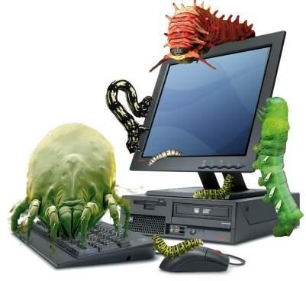
Malware
CSCA0101 Computing Basics
Types of Malware
Viruses
Trojan horses
Worms
Spyware
Zombie
Trapdoor/Backdoor
Rootkits
Adware
Ransomware
4

Slide 6
Malware
CSCA0101 Computing Basics
Types of Malware
Viruses
A program or piece of code that is loaded onto your computer without your knowledge and runs against your wishes.
Viruses can also replicate themselves.
All computer viruses are manmade.
Viruses copy themselves to other disks to spread to other computers.
They can be merely annoying or they can be vastly destructive to your files.
5

Slide 7
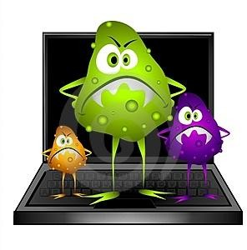
Malware
CSCA0101 Computing Basics
Types of Malware
Viruses
Examples of computer viruses are:
  Macro virus
  Boot virus
  Logic Bomb virus
  Directory virus
  Resident virus
We will discuss about virus in detail later!
6

Slide 8
Malware
CSCA0101 Computing Basics
Types of Malware
Trojan Horses
A Trojan Horse program has the appearance of having a useful and desired function.
A Trojan Horse neither replicates nor copies itself, but causes damage or compromises the security of the computer.
A Trojan Horse must be sent by someone or carried by another program and may arrive in the form of a joke program or software of some sort.
These are often used to capture your logins and
passwords.
7

Slide 9
Malware
CSCA0101 Computing Basics
Trapdoor/Backdoor
A secret, undocumented entry point into a module which allows a specialized access.
The trapdoor is inserted during code development ▪ Test the modules, allow access in events of error
Trapdoor are vulnerabilities because they expose the system to modification during execution.
The programmer usually removes trapdoors during program development. But sometimes
  forget to remove them
  leaves them in the program for testing and maintenance
  or as a covert means of access to the routine after it becomes an accepted production program.
8

Slide 10
Malware
CSCA0101 Computing Basics
Trapdoor/Backdoor
It can be used by anyone who discovers the trapdoor by accident or exhaustive trials.
Examples of trapdoors in program development which can be abused
  Debugging/testing software modules using drivers and stubs and debug control sequences
  Poor quality program, e.g use of CASE statement which captures all “defaults”
  Unused opcodes in hardware design which can be exploited to do other undocumented things
Trapdoors are generally desirable in program development
  auditors introduce fictitious transaction and trace the effect
  important for program maintenance
9

Slide 11
Malware
CSCA0101 Computing Basics
Types of Malware
Worms
A computer worm is a self-replicating computer program.
It uses a network to send copies of itself to other nodes (computers on the network) and it may do so without any user intervention.
It does not need to attach itself to an existing
program.

Slide 12
Malware
CSCA0101 Computing Basics
Types of Malware
Spyware
Spyware is a type of malware installed on computers that collects information about users without their knowledge.
The presence of spyware is typically hidden from the user and can be difficult to detect.
Spyware programs lurk on your computer to steal important information, like your passwords and logins and other personal identification information and then send it off to someone else.

Slide 13
Malware
CSCA0101 Computing Basics
Types of Malware
Rootkits
A rootkit is a clandestine computer program designed to provide continued privileged access to a computer while actively hiding its presence.
The term rootkit is a connection of the two words "root" and "kit." Originally, a rootkit was a collection of tools that enabled administrator-level access to a computer or network.
Root refers to the Admin account on Unix and Linux systems, and kit refers to the software components that implement the tool.

Slide 14
Malware
CSCA0101 Computing Basics
Types of Malware
Rootkits
Pre-packaged software to hide malware
Freely obtainable (rootkit.org)
There are even commercial packages!
Insert hooks into system, kernel
Trap program calls to list directory contents, running processes, registry entries
Filter out what the bad guys don’t want you to see

Slide 15
Detecting Rootkits
Look for the hooks
Look for known file names, processes
Look for what’s being hidden
Difficult to do, getting more difficult
Tools exist to do this, but most don’t detect everything
Hot topic of research for both sides

Slide 16
Removing Rootkits
Are you sure you wouldn’t rather R/R?
Removal tools exist for most rootkits
Deep magic, requiring wizardry and time

Slide 17
Malware
CSCA0101 Computing Basics
How Malware Spreads?
Malware is a program that must be triggered or somehow executed before it can infect your computer system and spread to others.
Here are some examples distributed:
  Social network
  Pirated software
  Removable media
  Emails
  Websites
on how malware is

Slide 18
Malware
CSCA0101 Computing Basics
Damages
1. Data Loss
Many viruses and Trojans will attempt to delete files or wipe hard drives when activated, but even if you catch the infection early, you may have to delete infected files.
2. Account Theft
Many types of malware include keylogger functions, designed to steal accounts and passwords from their targets.
This can give the malware author access to any of the user's online accounts, including email servers from which the hacker can launch new attacks.

Slide 19
Malware
CSCA0101 Computing Basics
Damages
3. Botnets
Many types of malware also subvert control over the user's computer, turning it into a "bot" or "zombie."
Hackers build networks of these commandeered computers, using their combined processing power for tasks like cracking password files or sending out bulk emails.

Slide 20
Malware
CSCA0101 Computing Basics
Damages
4. Financial Losses
If a hacker gains access to a credit card or bank account via a keylogger, he can then use that information to run up charges or drain the account.
Given the popularity of online banking and bill payment services, a hacker who manages to secrete a keylogger on a user's system for a full month may gain access to the user's entire financial portfolio, allowing him to do as much damage as possible in a single attack.

Slide 21
Malware
CSCA0101 Computing Basics
How Can You Protect Your Computer?
Install protection software.
Practice caution when working with files from unknown or questionable sources.
Do not open e-mail if you do not recognize the sender.
Download files only from reputable Internet sites.
Install firewall.
Scan your hard drive for viruses monthly.

Slide 22
Malware
CSCA0101 Computing Basics
Symptoms
Increased CPU usage
Slow computer or web browser speeds
Problems connecting to networks
Freezing or crashing
Modified or deleted files
Appearance of strange files, programs, or desktop icons
Programs running, turning off, or reconfiguring themselves (malware will often reconfigure or turn off antivirus and firewall programs)

Slide 23
Malware
CSCA0101 Computing Basics
Symptoms
Strange computer behavior
Emails/messages being sent automatically and without user’s knowledge (a friend receives a strange email from you that you did not send)
There seems to be a lot of network activity when you are not using the network
The available memory on your computer is lower than it should be
Programs or files appear or disappear without your knowledge
File names are changed

Slide 24
Now Let’s Talk about Viruses
Types of viruses
How viruses attach
How viruses gain control
Homes of viruses
Virus signature
Source of viruses
Preventing virus infection
Facts and misconceptions about viruses

Slide 25
Program Flaws
Programs behaving unexpectedly
There are no techniques to stop all program flaws
  Program controls apply at the level of the individual program and programmer
  Software engineering techniques change very rapidly
Virus - A program that can pass malicious code to other non malicious programs by modifying them
  Transient - Runs when its attached program executes and terminates when its attached program ends
  Resident - Locates itself in memory so that it can remain active even after its attached program ends

Slide 26
Kinds of Malicious Code (continued)
Trojan Horse -A type of program that is often confused with viruses is a 'Trojan horse' program. This is not a virus, but simply a program (often harmful) that pretends to be something else. For example, you might download what you think is a new game; but when you run it, it deletes files on your hard drive. Or the third time you start the game, the program E-mails your saved passwords to another person.
Logic Bomb - A class of malicious code that detonates when a specified condition occurs
Trapdoor - A feature in a program by which someone can access the program other than by the obvious direct call (perhaps with special privileges)

Slide 27
Kinds of Malicious Code (continued)
Worm- A computer WORM is a self-contained program (or set of programs), that is able to spread functional copies of itself or its segments to other computer systems (usually via network connections). Note that unlike viruses, worms do not need to attach themselves to a host program. There are two types of worms--host computer worms and network worms.

Slide 28
Some Deadliest Computer Viruses of All Time
ILOVEYOU: ILOVEYOU is considered one of the most virulent computer virus ever created. 10% of the world’s computers were believed to have been infected. What it did was use social engineering to get people to click on the attachment; in this case, a love confession. The attachment was actually a script that poses as a TXT file. It was so bad that governments and large corporations took their mailing system offline to prevent infection. Cost of the malware: $10 billion.
Code Red: Code Red first surfaced on 2001 and was discovered by two eEye Digital Security employees. The malware targeted computers with Microsoft IIS web server installed, exploiting a buffer overflow problem in the system. Once infected, it will proceed to make a hundred copies of itself but due to a bug in the programming, it will duplicate even more and ends up eating a lot of the systems resources.
MyDoom: MyDoom is considered to be the most damaging virus ever released. In 2004, roughly somewhere between 16-25% of all emails had been infected by MyDoom. Cost of the malware: $38 billion.
Slammer: Slammer is the kind of virus that makes it into films, as only a few minutes after infecting its first victim, it was doubling itself every few seconds. 15 minutes in and Slammer had infected half of the servers that essentially ran the internet. The Bank of America’s ATM service crashed, 911 services went down, and flights had to be cancelled because of online errors. Slammer, quite aptly, caused a huge panic as it had effectively managed to crash the internet in 15 quick minutes.

Slide 29
How Viruses Attach
Appended Viruses - Virus code attaches itself to a program and is activated whenever the program is run.
+
=
Virus Code
Virus Code
Original
Program
Original
Program

Slide 30
How Viruses Attach (continued)
Viruses that surround a program - Virus code runs the original program but has control before and after its execution.
Original
Program
Virus Code
Part a
Virus Code
Original
Program
Virus Code
Part b

Slide 31
How Viruses Attach (continued)
Integrated Viruses - Virus program replaces some of its target, integrating itself into the original code of the target.
+
Virus Code
=
Modified
Program
Original
Program

Slide 32
How Viruses Attach (continued)
Viruses That Replace a Program - Virus code replaces the target, either mimicking the effect of the target or ignoring the expected effect of the target and performing only the virus effect.

Slide 33
How Viruses gain control (Continued)
Virus changes the pointers in the file table so that V is located instead of T whenever T is accessed though the file system.
T = Target
V = Virus
File
Directory
File
Directory
V
V
T
T
T
Disk Storage
Disk Storage

Slide 34
Parts of a Virus
• Three Parts
Infection Mechanism: The means by which a virus spreads, enabling it to replicate, also referred as Infection Vector.
Trigger: The event or condition that determines when the payload is activated or delivered.
Payload: The payload may involve damage or may involve benign but NOTICEABLE activity.

Slide 35
Virus Template
program virus :="this is a virus" (marker)
subroutine infect–executable :=
{loop: file :=get random–executable–file;
if first–line–of–file = "this is a virus"
then go to loop;
prepend virus to file;
}
replication
subroutine do–damage := {whatever damage you wish to do}
mission
subroutine trigger–pulled := {return true if some condition
holds (e.g., today = April 1) }
trigger
main program := {infect executable;
if trigger–pulled then do–damage;
goto rest of program;}
rest of program;}
(from Fred Cohen's Ph. D. thesis)

Slide 36
Types of Viruses
On the basis of target
• Boot Sector Infector: Infects master boot record / boot record (boot sector) of a disk and spreads when a system is booted with an infected disk (original DOS viruses). They are Memory-resident Virus.
• File Infector : Infects executable ﬁles, they are also called Parasitic Virus as they attach their self to executable ﬁles as part of their code. Runs whenever the host program is executed.
• Macro Virus: Infects ﬁles with macro code that is interpreted by the relevant application, such as doc or excel ﬁles.

Slide 37
Types of Viruses
On the basis of concealment strategy
• Encrypted Virus: A portion of virus creates a random encryption key and encrypts the remainder of the virus. The key is stored with the virus. When the virus replicates, a diﬀerent random key is generated.
• Stealth Virus: explicitly designed to hide from Virus Scanning programs.
• Polymorphic Virus: mutates with every new host to prevent signature detection, signature detection is useless.
• Metamorphic Virus: Rewrites itself completely with every new host, may change their behavior and appearance.

Slide 38
Homes for Viruses
Boot Sector
Memory
Other Homes
  Application Programs
  Libraries

Slide 39
Boot Sector Viruses
Boot sector
The portion of a disk reserved for the bootstrap loader (the self-starting portion) of an operating system. The boot sector typically contains a short machine language program that loads the operating system.
An especially appealing place to house a virus
  Virus gains control very early in the boot process before most detection tools are active
  Operating systems usually make files in the boot area invisible to the user, therefore, virus code is not readily noticed

Slide 40
Memory Resident Viruses
Virus attaches itself to memory resident code
  Virus is activated many times while the machine is running
  Once activated it looks for and infects uninfected carriers

Slide 41
Other Homes for Viruses
Application Programs
  Virus macro adds itself to startup directives
  Virus embeds itself in data files
Libraries - Desirable home for viruses
  Used by many programs
  Shared between users
  Spreads infections to compilers, linkers, runtime debuggers, etc.

Slide 42
Virus Detection
Virus Signature - The execution and spreading characteristics of a virus have certain telltale patterns
Virus signatures are used by virus scanners to detect the virus
  Storage Patterns
  Execution Patterns
  Transmission Patterns

Slide 43
Storage Patterns
Virus attaches itself to a file and changes its size
Virus obliterates all or part of the underlying program, not affecting its size, but impairing its function

Slide 44
How Virus Scanner detects Storage Patterns
Use a code or checksum to detect changes to a file
Look for suspicious patterns such as a JUMP instruction as the first instruction of a system program

Slide 45
Transmission Patterns
Not confined to a single medium or execution pattern. Example:
  Virus arrives on a disk or from the network
  Travels to a hard disk boot sector
  Reemerges when computer is next booted
  Remains in memory to infect other desks

Slide 46
Virus & Malicious Code Defense
NO REASON NOT TO HAVE VIRUS PROTECTION
ALWAYS KEEP YOUR VIRUS DEFINITIONS UPDATED
ALWAYS SCAN ON A REGULAR BASIS

Slide 47
Preventing Virus Infection
Use only commercial software acquired from reliable, well established vendors
Test all new software on an isolated computer
Make a bootable disk and store it safely
Make and retain backup copies of executable system files
Use virus detectors regularly

Slide 48
Malware
CSCA0101 Computing Basics
Anti-Malware Program
Anti-Malware program is used to prevent, detect, and remove computer viruses, worms, trojan horses and any other type of malware.
Examples of Anti-Malware program:
  Antivirus program
  Anti-spyware program
  Anti-spam program
  Firewall

Slide 49
Malware
CSCA0101 Computing Basics
Antivirus Program
“Antivirus" is protective software designed to defend
your computer against malicious software.
In order to be an effective defense, the antivirus software needs to run in the background at all times, and should be kept updated so it recognizes new versions of malicious software.

Slide 50
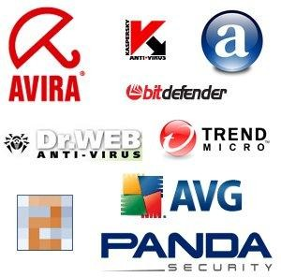
Malware
CSCA0101 Computing Basics
Examples of Antivirus Program
Norton Antivirus
AVG
Kaspersky
Avast!
PC-Cilin
McAffee
Avira

Slide 51
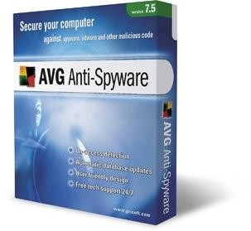
Malware
CSCA0101 Computing Basics
Anti-Spyware Program
Anti-spyware program is a type of program designed to prevent and detect unwanted spyware program installations and to remove those programs if installed.
Examples of Anti-spyware program:
  Spyware Doctor
  AVG Anti-spyware
  STOPzilla
  Spysweeper

Slide 52
Malware
CSCA0101 Computing Basics
Anti-Spam Program
Anti-spam software tries to identify useless or
dangerous messages for you.
Firewall
A firewall blocks attempts to access your files over a
network or internet connection.
That will block incoming attacks.
Your computer can become infected through shared disks or even from another computer on the network.
So you need to monitor what your computer is putting out over the network or internet also.

Slide 53
Quick Virus Safeguard Plan
Limit sharing of software
Be ready - have staff prepared
Use virus detection software
BACKUP YOUR DATA
Central security management should know what you have
Shut down your computer as quickly as possible if infected
Remember: always report incident to the appropriate support staff for action

Slide 54
How do I fix an infected off-campus or personal computer?
CSCA0101 Computing Basics
Shut down your computer as quickly as possible.
From another computer, download the latest version of your antivirus software to a removable storage device.
Update the virus definitions and then scan the infected computer to remove any malware it finds.
If you are unable to fix the problem yourself, consider using an off-campus computer repair service.
Once the infection has been successfully removed, use update to download and install the latest security patches for your computer and review and adjust your computer's firewall or other security settings.

Slide 55
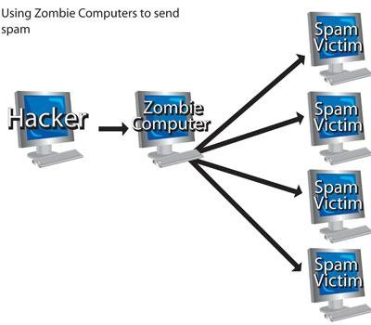
Malware
CSCA0101 Computing Basics
Types of Malware
Botnets/Zombie
Botnets/Zombie programs take control of your computer and use it and its Internet connection to attack other computers or networks or to perform other criminal activities.

Slide 56
Botnets
“The single greatest threat facing humanity”
Quickly becoming a top problem on campus
Hordes of infected “drone” hosts
Used for spam relay, DDOS, scanning, infection

Slide 57
Botnets, Cont.
Spreading via IM, email, compromise
Installs remote-control software
Connects to central server to announce presence and await commands
Allows “Botmaster” to control 100, 1000, 10000+ infected hosts with simple commands
Continually evolving

Slide 58
Botnets, Cont. 2
Network connections are initiated by the drone hosts
Uses common protocols: HTTP, IRC, FTP
Starting to see stealth techniques employed to hide infection (rootkits), communications (SSL, steganography)
Tremendous incentives for Botmasters to grow, maintain, defend their horde
You don’t want this on your computer

Slide 59
Malware
CSCA0101 Computing Basics
Types of Malware
Adware
Adware (short for advertising-supported software) is a type of malware that automatically delivers advertisements.
Common examples of adware include pop-up ads on websites and advertisements that are displayed by software.
Often times software and applications offer “free” versions that come bundled with adware.

Slide 60
Malware
CSCA0101 Computing Basics
Types of Malware
Ransomware
Ransomware is a form of malware that essentially holds a computer system captive while demanding a ransom.
The malware restricts user access to the computer either by encrypting files on the hard drive or locking down the system and displaying messages that are intended to force the user to pay the malware creator to remove the restrictions and regain access to their computer.

Slide 61
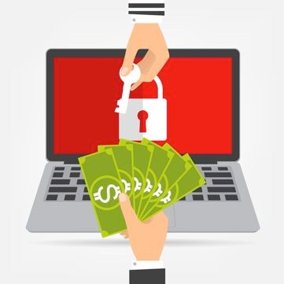
Ransomware
A type of malware that prevents users from accessing their system, A form of malware that targets your critical data and systems for the purpose of extortion.
  Either by locking the system's screen or by locking the users' files unless a ransom is paid
  Crypto-ransomware
The biggest cybersecurity threat

Slide 62
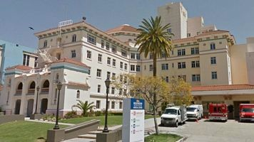
Who gets hit by ransomware?
Hospitals
  Hollywood Presbyterian Medical Center, whose network effectively ground to a halt after hackers breached the system. After relying on pen and paper records briefly, Hollywood Presbyterian paid the 40 bitcoin ($17,000) ransom to regain control of its network.
http://www.pcmag.com/article2/0,2817,2499469,00.asp

Slide 63
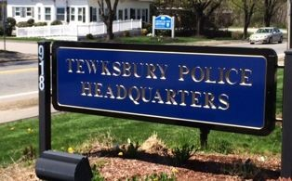
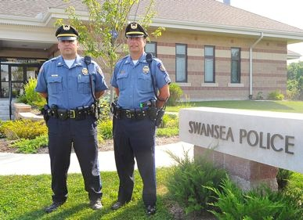
Who gets hit by ransomware?
Police
  A police department in Tewksbury, Massachusetts, made a
$500 payment after enlisting the help of the FBI.
  A police computer in Swansea, Massachusetts. The police department decided to pay the ransom of 2 Bitcoins (about
$750) rather than try to figure out how to break the lock.
http://www.pcmag.com/article2/0,2817,2499469,00.asp

Slide 64
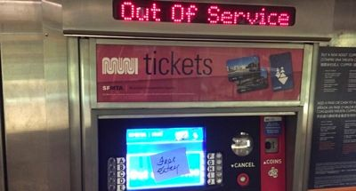
San Francisco Transport system
Nov 28, 2016
  By a variant of HDDCryptor to encrypt hard drives and network-shared files, and overwrite the master boot record (MBR)
  Free rides for all as 100 bitcoin ($73,000) demanded

Slide 65

Welcome to Las Vegas!
“Las Vegas, Rust Belt, Hit Hardest By Ransomware”
  Dark Reading, 12/8/2016
  Study of 400,000 ransomware by malwarebytes
Top 10 US Cities for Ransomware Detections
Las Vegas/Henderson, Nev.
Memphis, Tenn.
Stockton, Calif.
Detroit, Mich.
Toledo, Ohio
Cleveland, Ohio
Columbus, Ohio
Buffalo, N.Y.
San Antonio, Texas
Fort Wayne, Ind.
http://www.darkreading.com/endpoint/las-vegas-rust-belt-hit-hardest-by-ransomware------------/d/d-id/1327664

Slide 66
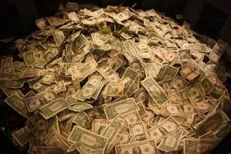
Why such a boom in ransomware?
Money!
  Virus, worms were for fun
  Ransomware is purely for money
Ransomware as a service
  Separation of production and distribution
  Getting easier!
Hard to catch the criminal
  Previous digital crimes (e.g., farming, Zeus) were easier to catch (stealing bank account number, mule, ATM/Camera)
  Bitcoin is virtual!

Slide 67
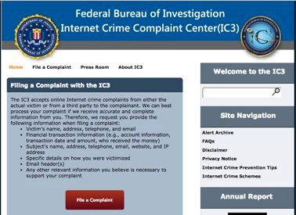
Reporting ransomware incidents
https://www.ic3.gov/media/2016/160915.aspx
https://www.ic3.gov/default.aspx

Slide 68
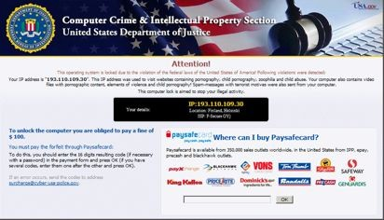
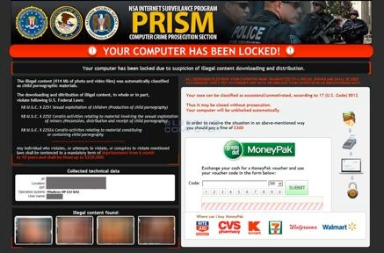
Police Ransomware/FBI Ransomware
Reveton (2012) is a ransomware that impersonates law enforcement agencies. (not crypto-ransomware)
  Show a notification from law enforcement, informing them that they were caught doing an illegal activity online (child porn, etc). Threatened to arrest. Locked screen.
  Contact at fines@fbi.gov
  Demand payments through Ukash, PaySafeCard, MoneyPak

Slide 69
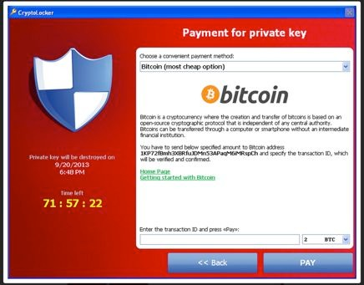
The First Major Ransomware
2013, Cryptolocker
  Crypto-ransomware
  Spread via an email purporting to
  Demanded $400 in bitcoin in 72 hours
  Infected half million, 1.3% paid
  Estimated payment of $27M
Operation Tovar
  International collaboration to crack down Gameover Zeus botnet and Cryptolocker
  Russian hacker got charged
  The captured information allowed 500,000 victims to find the key without paying ransom
come from UPS or FedEx.

Slide 70
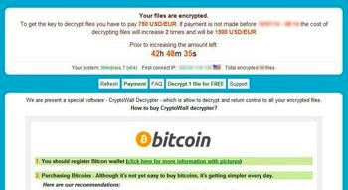
Copycats
CryptoDefense
  After 4 days the ransom doubled
  Poorly implemented - Left decryption key!
2014, Cryptowall
  Improved version
  Contains junk code and anti-emulation features (anti-AV)
  Demanded $500 in Bitcoin
  Provided decryption of one file for verification via a TOR
  Variants: Cryptorbit, CryptoDefense, Cryptowall 2.0, Cryptowall 3.0 (uses I2P network proxies)

Slide 71
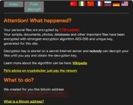
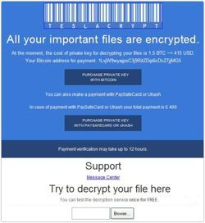
More crypto-ransomware
TorrentLocker, 2015
  Harvests victims’ email addresses to spam other victims
CTB-Locker, 2015
  Curve-TOR-Bitcoin (CBT)
  Uses Elliptic curve crypto
  TOR component is embedded
  Facebook/Chrome suspension warning
TeslaCrypt, Feb 2015
  Targeted video game community
  Deleted shadow volume copies
https://www.wired.com/2015/09/hacker-lexicon-guide-ransomware-scary-hack-thats-rise/

Slide 72
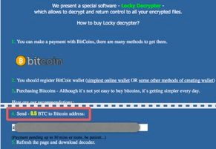
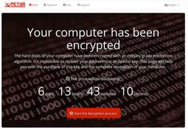
More crypto-ransomware
Locky, Feb 2016
  Distributed as a Word macro attachment
  Deletes shadow copies
  Used in healthcare facilities
  Changes file extension to .locky
Petya, Mar 2016
  Overwrites master boot record (MBR)  disables booting
  Delivered through legitimate cloud such as Dropbox
  Decrypted thanks to sloppy implementation
Cerber, Mar, 2016
  Voice feature
https://www.wired.com/2015/09/hacker-lexicon-guide-ransomware-scary-hack-thats-rise/ http://thehackernews.com/2016/04/ransomware-decrypt-tool.html

Slide 73
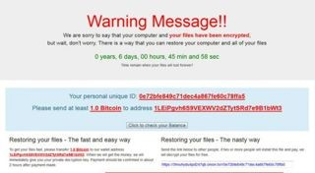
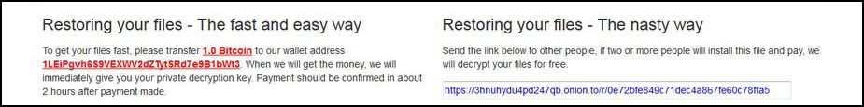
Free decryption, if you infect two!
Popcorn Time
  Dec 8, 2016
https://www.bleepingcomputer.com/news/security/new-scheme-spread-popcorn-time-ransomware-get-chance-of-free-dPeacrgyepti2o6n-key/

Slide 74
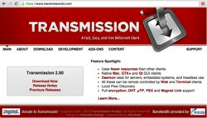
Ransomware for Mac
Mac: only 7.4% of global market share of PC
March, 2016
  First live Ransomware for Mac found: KeRanger
  Compromised Transmission, a popular BitTorrent client
  Sleeps 3 days before activation
  Demand 1 bitcoin (~$400)

Slide 75
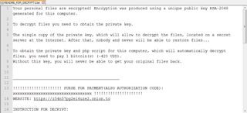
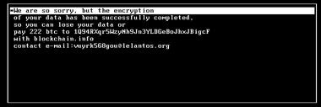
Ransomware for Linux
November, 2015
  Linux.Encoder.1 ransomware
  Infects Magento
January, 2017
  KillDisk Ransomware targets Linux
  Wipes disk
  Demand 222 Bitcoins (~$218,000) !
  Researchers found a way to recover the key

Slide 76
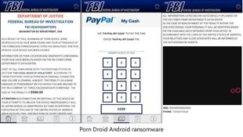
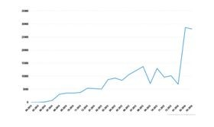
Mobile Ransomware
50% increase in one year (Feb 2017), ZDnet
Android
  Porn Droid app locks the phone and change its PIN number while demanding a $500 ransom from victims.
https://www.wired.com/2015/09/hacker-lexicon-guide-ransomware-scary-hack-thats-rise/ http://www.zdnet.com/article/android-ransomware-attacks-have-grown-by-50-percent-in-a-year/

Slide 77
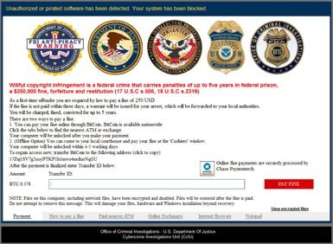
Ransomware for Cloud
Cloud storage ransomware usually self-propagates after being installed on cloud servers
  With Cloud synch, cloud collaboration
  E.g., Virlock (2014) (2016cloud version)
    It impersonates FBI authorities and requests victims to pay the fine of $250 due to alleged misconduct.

Slide 78
Ransomware Incident handling

Slide 79
Infected! What now?
Can you stop it now? 
Got backup? 
Recovery tools exist? 
Do something!!!
Restore files Recover files Pay ransom
4. Ummm, no…
Lose the files

Slide 80
1. Do Something!!
By the time the ransom notice pops up, it is too late
Kill the suspicious programs
  E.g., ransom.exe
Change file extensions to uninteresting extensions (e.g., .pdf  myp) to hide them from ransomware
  It can be done in advance as a preparation
  You can write a emergency script in advance
But can you stay calm enough?
  Besides, cmd, ctrl-alt-del, Process Explorer may not work

Slide 81
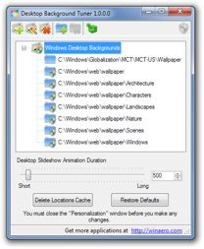
Delay Tactic
Ransomware scans file from C:\ drive, and encrypt files in alphanumeric order
  Keep many large junk files in C:\ directory
Helps detection
  Store desktop background files in C:\
  Reload them frequently (slideshow)
  Image is gone after encryption

Slide 82
Emergency measure
Unplug power or remove notebook battery
If safe mode booting is possible, boot into safe mode
  Remove the ransomware using AV
If not, mount the hard drive on another OS, and copy the files to a backup drive, and reinstall Windows
  If keys and tools available, use the tools to decrypt the files
Hard drive MBR encryption ransomware won’t allow any kind of booting including safe mode
  e.g., Petya, Mischa, Goldeneye, Santana
  Need to recover MBR using Windows CD

Slide 83
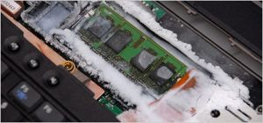
Keeping the encryption key
The AES key is kept in the memory, which will be removed after encryption
  Freezing the memory will preserve the AES keys, but shutting down will destroy DRAM content
Solutions
  After emergency shutdown, freeze the memory with hair spray, and thaw later for analysis (lasts a few days easily)
  No hair spray? Hard reset, boot into Linux, and memory dump (dd)

Slide 84
2. Backup, yes, BACKUP!
The most important methods!!!
  Back up multiple versions over time to recover the pre- encryption files
Types
External hard drive: Not very useful
  Vulnerable to Ransomware attack
  Must have been disconnected while attack occurred
DVD-ROM
NAS
  Ransomware won’t start within NAS due to different OS, and lack of access rights
  Make the SMB read only, upload files using sftp
Cloud service

Slide 85
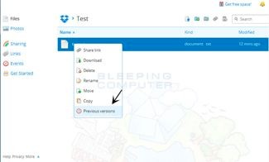
Cloud Services
Google drive, Dropbox, Amazon, Backblaze, Crashplan, etc.
File history is usually available
  Exception: MS OneDrive does not have history

Slide 86
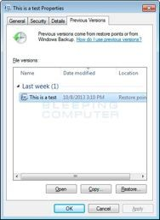
3. Recover files
Windows Shadow Volume Copies
  Windows creates shadow copy snapshots that contain copies of the files when the system restore snapshot was created.
  These snapshots may allow us to restore a previous version of our files from before they had been encrypted.
Ransomware will attempt to delete all VSS, but it may fail

Slide 87
Forensic techniques
Recover deleted files
  If the ransomware did not overwrite them (not Cryptowall 2.0 or later), it may be possible to recover. (works on TeslaCrypt)
  Even if it did, it may not actually overwrite the same sector due to wear-leveling algorithm in case of SSD
  DIY: Use R-studio, or Photorec
  Call the forensic experts
    But may be more expensive than ransom and take longer time
Recover windows temporary files
  Deleted upon finishing editing, but not the file content
Caution:
  Do not continue to use the machine. It makes the forensic file recovery more difficult

Slide 88

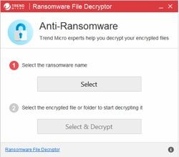
Recover Files Using Free Tools
Kaspersky
  Free ransomware decryptors
  https://
noransom.kaspersky.com/
Trend Micro
  Ransomware File Decryptor
  https://
success.trendmicro.com/ solution/1114221- downloading-and-using-the- trend-micro-ransomware-file- decryptor

Slide 89
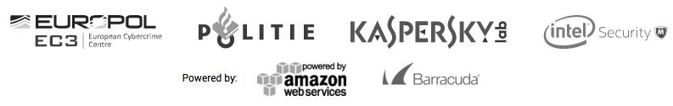
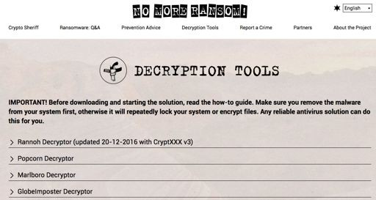
No More Ransom
Industry consortium
  https://www.nomoreransom.org/
DECRYPTION TOOLS FOR 109 RANSOMWARE STRAINS

Slide 90
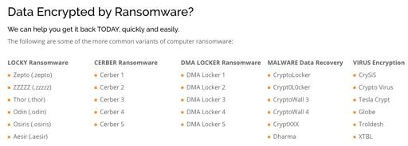


Commercial services
http://www.rm-ransomwarerecovery.com/
Other services
  Axiom cyber solutions
    https://www.axiomcyber.com/
  Secured IT Solutions
    http://www.secureditsolutions.com

Slide 91
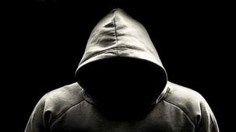
To Pay or Not to Pay
Chance of getting the key
  Was high previously. Attackers needed to build trust to encourage ransom payment. Had a good customer service.
  Now getting lower due to more irresponsible nomadic attackers
Out of 5 who paid, 1 didn’t get the key
  Getting lower because customer service (trouble shooting capability) is getting worse as more criminals don’t have the programming skills

Slide 92

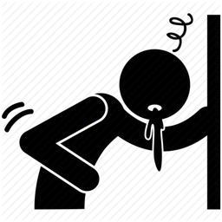
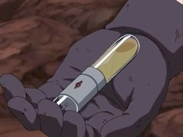
Dilemma
Doctor ($5,000) or Antidote ($500)?
Cybersecurity ($5,000) or Ransom ($500)?
  E.g., 2 experts working for 25 hours at $100/hour = $5,000 (and not guaranteed)
Quickest, cheapest, and cleanest way
  Ransom!
  Much safer

Slide 93
Real Loss: Productivity hit
“How Ransomware Became a Billion-Dollar Nightmare for Businesses”, Sep 3, 2016
  Extortive attacks now cost companies at least $75 billion in expenses and lost productivity each year.
  Less than 1 in 4 attacks are reported
  Banks are stocking bitcoins in preparation

Slide 94
How much?
Pain level vs. amount willing to pay
Willing to pay
$$$
Rich
Poor
Pain level
Study by SkyHight security
  A quarter of companies (24.6%) would pay a ransom, even if such amount exceeds USD 1 million (14% respondents).

Slide 95
Who pays?
Ransom payment rate by Osterman research
  Nearly 60 percent demanded over $1,000.
  Over 20 % asked for more than $10,000, 1 % even asked for over $150,000.
  Globally, more than 40 % of victims paid the ransom.
  Healthcare and financial services were the leading industries
    penetration rate of 39 %
  Potential loss of life: 3.5 % even said lives were at stake
IBM security
  70% of business victims paid
  Of those, 50% paid more than $10,000, 20% more than
$40,000

Slide 96
Hiding files and data

Slide 97
File Hiding
ADS (Alternate Data Stream): feature of the Windows New Technology File System (NTFS)
  It has the ability of forking data into an existing file without changing its file size or functionality
  Think of ADS as a file inside another file
ADS exists in all versions of Microsoft’s NTFS file system
  It has been available since Windows NT was released

Slide 98
ADS, What can you do with?
ADS can allow you to store any type of file, such as texts, audios, videos, images, or even nefarious codes like viruses or trojans
ADS contains metadata for identifying files according to various attributes, such as author, title, date modified, and more
Hackers can use Alternate Data Streams to launch attacks

Slide 99
Benefits OF ADS
Windows Resource Manager leverages ADS to identify high risk files that shouldn’t be accessed
The Windows operating system uses ADS to encrypt and store files in a secure manner
The Windows Attachment Manager uses ADS as a file scanner
  This is why sometimes you receive warnings when you open a file downloaded from the Internet
Anti-virus applications, such as Kaspersky, may use ADS to enhance the files scanning

Slide 100
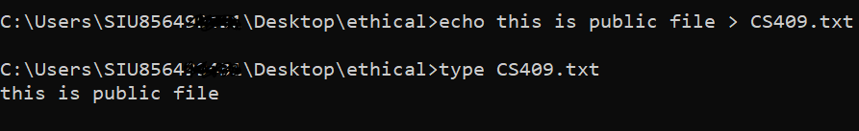
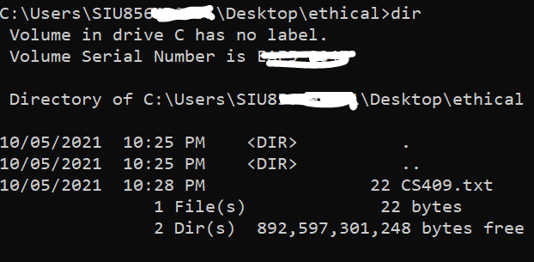
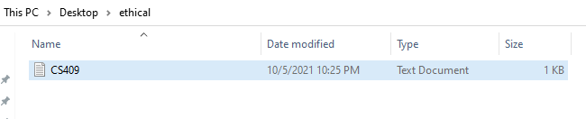
Before Creating ADS

Slide 101
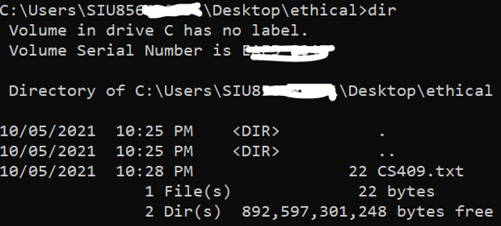
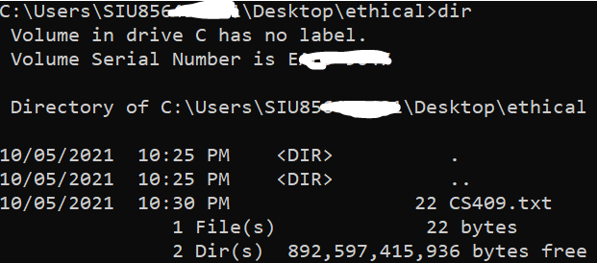
Comparison of Directory Listings:
Before & After
The file size remains unchanged as evidenced by the prefix 22 in CS409.txt when checking the directory listing
  Implies that you could have many ADS files within a file without your knowledge

Slide 102
Risks
Because of the subtle changes, it’s difficult to detect ADS files unless you use a third-party tool
Enables information to be hidden within other files which can be a security risk
Example:
  echo c:\windows\system32\cmd.exe > CS409Hack.txt:hidden
  The above command copies the Windows calculator program into an ADS file called cmd.exe, which is linked to CS409Hack.txt

Slide 103
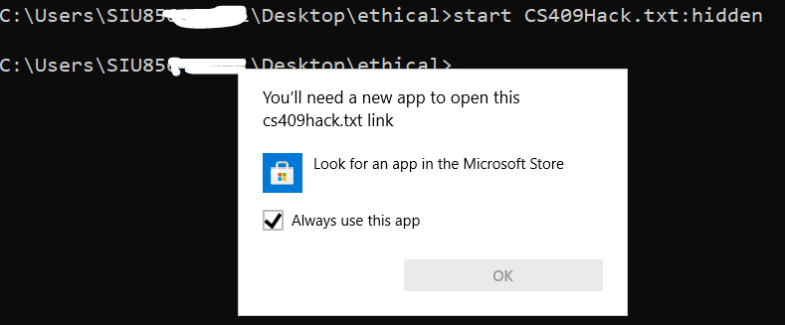
ADS Risk Example
To launch the hidden cmd.exe copy from its ADS in CS409Hack.txt, an attacker can run the following command
  start CS409Hack.txt:hidden

Slide 104

Data Hiding
Steganography
  The art and science of writing hidden messages in such a way that no one, apart from the sender and intended recipient, suspects the existence of the message

Slide 105
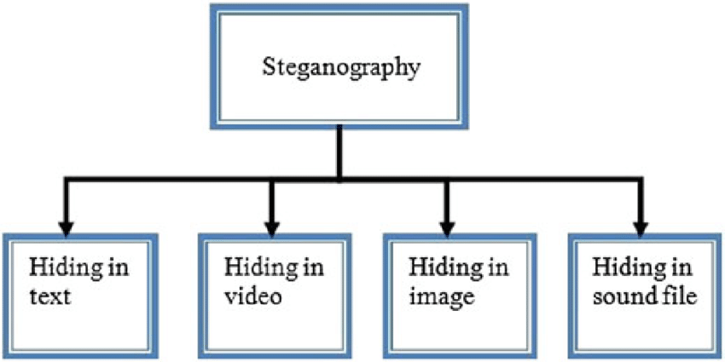
Steganography
The advantage of steganography over cryptography alone is that messages do not attract attention to themselves
  If someone is unaware the message is even there, s/he won’t try to decipher it
  Messages can be encrypted and hidden via steganography
  A form of security through obscurity
  The message is hidden in some other file such as a digital picture or audio file to defy detection

Slide 106
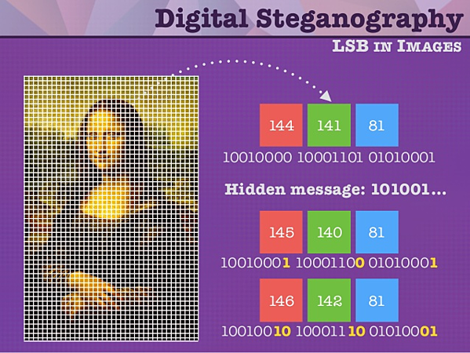
Steganography
The most common implementation of steganography utilizes the least significant bits (LSB) in a file in order to store data
  By altering the least significant bit, you can hide additional data without altering the original file in any noticeable way

Slide 107
How to Detect Steganography
Detecting steganography is not so simple
  By filling those LSBs in with data, data is able to be hidden
There are few effective ways to detect steganography directly, one example strategy :
  Hash Comparison
Stealing info in the images:
https://www.securityondemand.com/insider-uses-steganography-steal-trade-secrets-china/

Slide 108
Tools for Steganography
QuickStego: Easy to use but very limited
MP3Stego: Specifically for hiding payload in MP3 files
Stealth Files 4: Works with sound files, video files, and image files
SNOW (Steganographic Nature Of Whitespace): Hides data in whitespace
StegVideo: Hides data in a video sequence
Invisible Secrets: A very versatile steganography tool that has several options

Slide 109
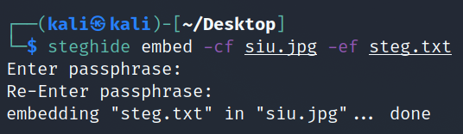
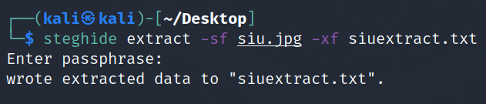
Steganography in Kali
steghide embed -cf siu.jpg -ef steg.txt
steghide extract -sf siu.jpg -xf siuextract.txt

Slide 110
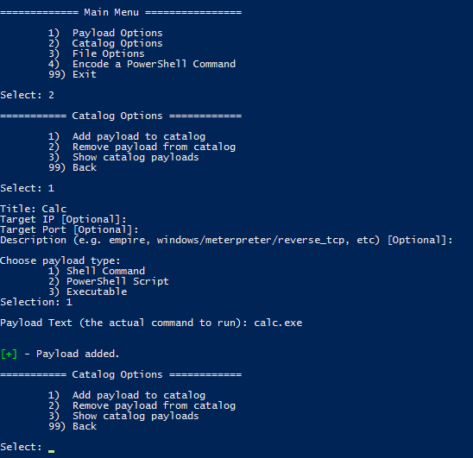
Lucky Strike
A PowerShell based utility for the creation of malicious Office macro documents
More tools:
  Office-DDE-Payloads
  wePWNise
  MacroShop
  Worse-PDF
https://github.com/curi0usJack/luckystrike
https://github.com/0xdeadbeefJERKY/Office-DDE-Payloads
https://github.com/FSecureLABS/wePWNise
https://github.com/khr0x40sh/MacroShop
https://github.com/3gstudent/Worse-PDF

Slide 111
Questions?

